Slide 1
Food supply, health and economic development in England and Wales during the 18th and 19th centuries
Food and Nutrition in 19th and 20th century Europe University of Sussex 12-13/5/16
Bernard Harris University of Strathclyde

Slide 2
Introduction and plan
Background
Corrections to The changing body
Extraction rates
Internal trade
The changing body: revised estimates
Comparing estimates
The composition of the British diet
The distribution of calories
Conclusions

Slide 3
Background
Source: Floud et al. 2011: 160.

Slide 4
Corrections to The changing body
Source: Harris et al. 2015: 118.

Slide 5
Extraction rates
‘Floud et al.’s assumed proportions of wheat, barley and rye entering gross product … seem to be on the low side [and] … the assumed losses from processing and distribution may be too high except, perhaps, in the case of barley’ (Kelly and O’Grada 2013b: 2)
Floud et al.’s ‘assumptions regarding loss … are arguably very high’ (Meredith and Oxley 2014: 179-80)

Slide 6
Extraction rates, cont.
 | Overton and Campbell (1996; 2006) |  |  |  | Floud et al. (2011)
 | Seeding | Fed to livestock | Processing and distribution | Wastage | Seeding | Fed to livestock | Processing and distribution | Wastage
Wheat | Constant value; declining proportion | Constant proportion (2%) | Constant proportion | Constant proportion | Constant proportion | Constant proportion | Constant proportion | Constant proportion
Rye | Constant value; declining proportion | Constant (zero) | Constant proportion | Constant proportion | Constant proportion | Constant proportion | Constant proportion | Constant proportion
Barley | Constant value; declining proportion | Increasing proportion (2% in 1700 and 1800; 4% in 1830; 5% in 1871) | Increasing proportion (as result of increase in proportion of crop used for brewing) | Constant proportion | Constant proportion | Constant proportion | Constant proportion | Constant proportion
Oats | Constant value; declining proportion | Increasing proportion (60% in1700; 70% in 1800; 80% in 1830; 90% in 1871) | Constant proportion | Constant proportion | Constant proportion | Constant proportion | Constant proportion | Constant proportion

Slide 7
Extraction rates, cont.
 |  | Crop | Floud et al. A |  |  |  | Floud et al. B
 |  |  | 1700 | 1750 | 1800 | 1850 | 1700 | 1750 | 1800 | 1850
(1) | Original conversion rates | Wheat | 502.43 | 657.28 | 732.04 | 706.28 | 502.43 | 804.29 | 717.77 | 729.03
(2) |  | Rue | 250.76 | 131.15 | 76.31 | 14.09 | 250.76 | 131.15 | 68.75 | 14.01
(3) |  | Barley | 598.22 | 421.05 | 314.98 | 227.49 | 598.22 | 417.67 | 306.75 | 226.80
(4) |  | Oats | 122.19 | 204.98 | 172.02 | 101.14 | 122.19 | 269.00 | 183.94 | 119.88
(5) |  | Total | 1473.60 | 1414.46 | 1295.35 | 1049.00 | 1473.60 | 1622.11 | 1277.21 | 1089.72
(6) | Broadberry et al.’s conversion rates | Wheat | 548.19 | 735.53 | 839.66 | 820.81 | 548.19 | 900.04 | 823.29 | 847.25
(7) |  | Rue | 359.69 | 197.28 | 120.11 | 22.18 | 359.69 | 197.28 | 108.22 | 22.05
(8) |  | Barley | 467.31 | 320.68 | 233.73 | 126.43 | 467.31 | 318.10 | 227.63 | 126.05
(9) |  | Oats | 154.69 | 233.13 | 173.52 | 52.35 | 154.69 | 305.95 | 185.54 | 62.05
(10) |  | Total | 1529.88 | 1486.62 | 1367.02 | 1021.77 | 1529.88 | 1721.37 | 1344.68 | 1057.40
(11) | (10)-(5) |  | 56.28 | 72.16 | 71.67 | (27.23) | 56.28 | 99.26 | 67.47 | (32.32)

Slide 8
Irish imports/exports
‘Scotland, Wales and especially Ireland were key suppliers [of English food]: as early as the 1750s and 1760s, beef imports from Ireland trebled, and there were big increases in butter and pork’ (Meredith and Oxley 2014: 172)
‘Allowing for imports of Irish meat and butter and … Scottish cattle would increase Broadberry et al.’s total by a further 60/75 kcals in 1800 and by perhaps 20/5 kcals in 1750. [Irish grain imports] accounted for about 100 kilocalories daily per head in 1850 and perhaps double that before the Great Famine’ (Kelly and Ó Gráda 2013a: 1154-5)

Slide 9
Irish imports/exports: Calories
 | 1700 | 1750 | 1800 | 1850
Grains* | 0.00 | 0.00 | 31.70 | 64.49
Beef and pork** | 0.00 | 0.00 | 10.52 | 5.83
Butter† | 0.00 | 0.00 | 21.77 | 50.71
Livestock | 0.00 | 0.00 | 5.30 | 33.84
Potatoes‡ | 0.00 | 0.00 | 19.77 | 0.00
Total | 0.00 | 0.00 | 89.06 | 154.87
Notes.
* The average number of calories derived from grain imports during the period 1841-5 was 140.86 calories.
** In estimating the calorific value of meat imports, we have assumed that 50% of the imported beef and pork was consumed elsewhere.
† We have also assumed that the number of calories derived from butter in 1850 was the same as the average figure for the years 1823-5.
‡ If we had used the recorded data for 1800, the calorific value of imported potatoes would have been worth 0.01 calories per person per day. If we had used Bourke’s figures to calculate the number of calories derived from potatoes in a ‘normal’ year and applied this figure to 1850 (i.e. ignored the effects of the Famine), the calorific value of potato imports in this year might have been equivalent to approximately 30 calories per person per day.

Slide 10
The changing body: corrected and revised estimates

Slide 11
Revised estimates: calories obtained from different food groups
 | Estimate A: Crop yields from Chartres, Holderness and Allen
 | Calories |  |  |  |  | Percentage
Source of calories | 1700 | 1750 | 1800 | 1850 | 1909-13 | 1700 | 1750 | 1800 | 1850 | 1909-13
Cereals | 1,517 | 1,318 | 1,485 | 1,433 | 999 | 66.37 | 54.94 | 56.41 | 54.44 | 33.55
Fish | 24 | 24 | 24 | 24 | 32 | 1.04 | 0.99 | 0.90 | 0.90 | 1.08
Fruit and vegetables (inc. potatoes) | 167 | 189 | 266 | 338 | 349 | 7.31 | 7.86 | 10.12 | 12.84 | 11.72
Meat and dairy products | 538 | 786 | 745 | 689 | 1,067 | 23.52 | 32.75 | 28.31 | 26.19 | 35.85
Other | 40 | 83 | 112 | 148 | 530 | 1.75 | 3.46 | 4.25 | 5.62 | 17.80
Grand total | 2,285 | 2,399 | 2,632 | 2,632 | 2,977 | 100.00 | 100.00 | 100.00 | 100.00 | 100.00
 | Estimate B: Crop yields from Turner, Beckett and Afton
 | Calories |  |  |  |  | Percentage
Source of calories | 1700 | 1750 | 1800 | 1850 | 1909-13 | 1700 | 1750 | 1800 | 1850 | 1909-13
Cereals | 1,517 | 1,553 | 1,463 | 1,469 | 999 | 66.37 | 59.40 | 56.37 | 55.06 | 33.55
Fish | 24 | 24 | 24 | 24 | 32 | 1.04 | 0.91 | 0.92 | 0.89 | 1.08
Fruit and vegetables (inc. potatoes) | 167 | 169 | 251 | 338 | 349 | 7.31 | 6.46 | 9.68 | 12.65 | 11.72
Meat and dairy products | 538 | 786 | 745 | 689 | 1,067 | 23.52 | 30.06 | 28.72 | 25.84 | 35.85
Other | 40 | 83 | 112 | 148 | 530 | 1.75 | 3.17 | 4.32 | 5.55 | 17.80
Grand total | 2,285 | 2,614 | 2,595 | 2,667 | 2,977 | 100.00 | 100.00 | 100.00 | 100.00 | 100.00

Slide 12
The distribution of calories: ‘A’ Estimates

Slide 13
The distribution of calories: ‘B’ Estimates

Slide 14
Food availability in England and Wales: Comparisons

Slide 15
Revised estimates from The changing body versus Muldrew
Energy values
Foodstuffs included
Dates of observation
Geographical area
Imports/ exports
Yields per acre
Land under cultivation
Extraction rates

Slide 16
Land under cultivation

Slide 17
Extraction rates
 |  | Muldrew |  |  |  |  | Floud et al.
 |  | Seed (%) | Fed to livestock (%) | % entering gross product | % of crop entering gross product net of milling and distribution | Gross extraction rate (%) | % entering gross product | % of crop entering gross product net of milling and distribution | Gross extraction rate (%)
1700 | Wheat | 14.7 | 0.0 | 85.3 | 92.5 | 78.9 | 85.5 | 61.9 | 52.9
 | Rye | 16.7 | 0.0 | 83.3 | 92.5 | 77.1 | 73.7 | 53.5 | 39.4
 | Barley | 20.0 | 0.0 | 80.0 | 73.0 | 58.4 | 85.0 | 40.0 | 34.0
 | Oats | 27.3 | 50.0 | 36.4 | 55.5 | 20.2 | 28.0 | 42.6 | 11.9
 | Beans and peas | 23.5 | 60.0 | 30.6 | 92.5 | 28.3 | 60.0 | 40.5 | 24.3
1800 | Wheat | 12.2 | 0.0 | 87.8 | 92.5 | 81.2 | 85.5 | 61.9 | 52.9
 | Rye | 9.8 | 0.0 | 90.2 | 92.5 | 83.4 | 73.7 | 53.5 | 39.4
 | Barley | 14.3 | 0.0 | 85.7 | 73.0 | 62.6 | 85.0 | 40.0 | 34.0
 | Oats | 15.8 | 20.0 | 70.3 | 55.5 | 39.0 | 28.0 | 42.6 | 11.9
 | Beans and peas | 17.0 | 60.0 | 33.2 | 92.5 | 30.7 | 60.0 | 40.5 | 24.3

Slide 18
A middle way?
‘In this paper, energy cost accounting has been tested using stature and dietaries, and all three complementary ways of measuring nutrition reach agreement. The answer is found when a deflated eighteenth-century Muldrew meets nineteenth-century Floud et al.’ (Meredith and Oxley 2014: 210)

Slide 19
Searching for compromise
Can we splice together a modified version of Muldrew’s figures for 1700, 1770 and 1800 with Floud et al.’s original figures for 1850 and 1909-13 and their figures for imported and exported goods over the whole period?
Bushels into pounds (wheat, rye)
Food into calories (beans and peas; meat and dairy products)
What are the implications of using Muldrew’s figures on land under cultivation for 1700-1800 for the development of agriculture after 1800?

Slide 20
Searching for compromise: Wages and prices
Sources: Wrigley and Schofield 1981: 642-4; Feinstein 1998: 648; Allen 2007: 36.
Source: Clark 2007: 130-4.

Slide 21
Searching for compromise: Heights
‘Four issues are involved in the use of the military height data. First is the question of whether the marines and the army recruits should be pooled, given there are significant height differences between marines and soldiers born before the end of the eighteenth century…. If they are drawn from the same population and subsequently sorted (by height), then they should be pooled. If they are recruited separately, and by different height standards, they should be separated… Secondly, given the difference in stature of marines and army recruits, if pooling, it is important not to over-sample from one group: Floud, Wachter and Gregory collected a disproportionate number of marines in order to gain five thousand of each group per decade. Just as it would be inappropriate to mix up disproportionate shares of males and females and consider the outcome representative, so too should marines and army be mixed with care: they need to be weighted accordingly…. Let us accept the logic of Floud, Wachter and Gregory on recruitment: marines and army were sorted (on the basis of height) after being measured at recruitment: the data should be pooled. However, let us weight the army and the marines proportionally, according to their share of recruitment: for example, in 1800, 92 per cent of recruits ended up in the army and only 8 per cent in the marines’ (Meredith and Oxley 2014: 187-8).

Slide 22
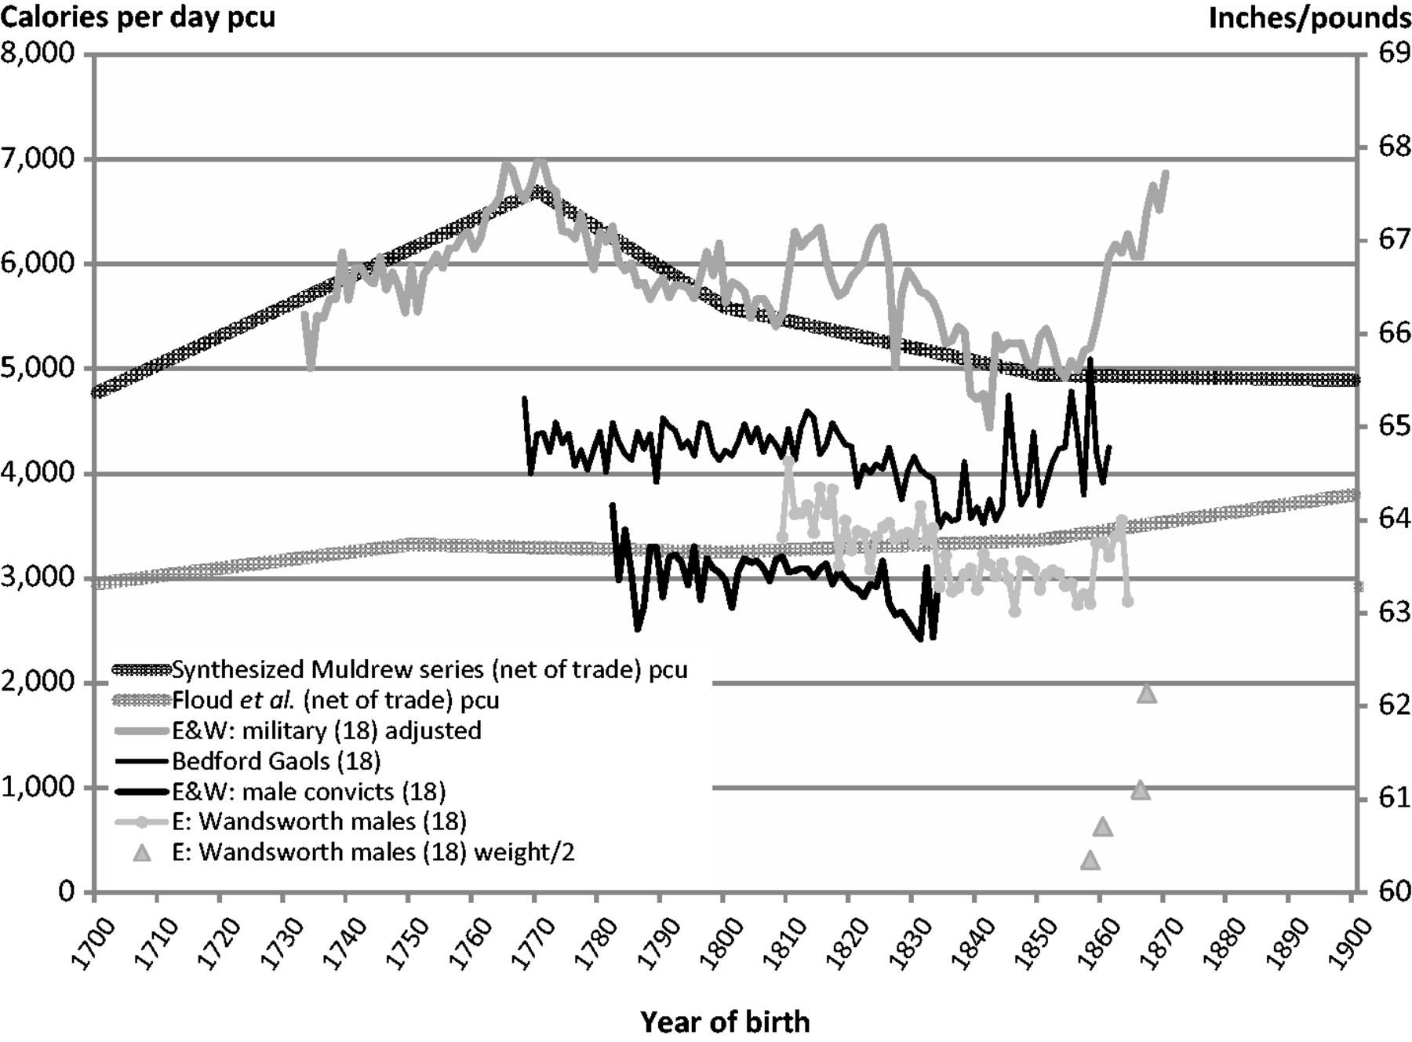
Searching for compromise: Heights, cont. Figures 9a and 9b
1775
1742
1777.5
Source: Floud, Wachter and Gregory 1990: 140-9.
Source: Oxley and Meredith 2014: Figure 4.

Slide 23
Searching for compromise: Mortality
Source: Floud et al. 2011: 146.

Slide 24
Conclusions
Height, health and mortality
Revised and corrected figures for Estimate A broadly consistent with previous arguments
Revised and corrected figures for Estimate B may be less so
But also need to consider changes in the distribution of calories within the population as well as changes in mean values

Slide 25
Conclusions, cont.
Adequacy
Original figures suggested that calories only began to reach conventional levels of adequacy after the middle of the nineteenth century
New figures suggest that this conclusion was too pessimistic
But also need to take account of the sources of calories (cereal %) and disease environment

Slide 26
Conclusions, cont.
Inequality
Between households
Within households
‘[In many parts of rural England], ‘the important practical fact is however well-established, that the labourer eats meat or bacon almost daily, whilst his wife and children may eat it but once a week, and that both himself and his household believe that course to be necessary, to enable him to perform his labour’ (Dr Edward Smith, in Parliamentary Papers 1864: 249)

